Slide 1





Gary T. Ciampa
Cloud Solution Architect
Azure Dev Day
gary.ciampa@microsoft.com
https://www.linkedin.com/in/gary-ciampa-cams-526945a/
https://github.com/garyciampa

Slide 2

Serverless Solutions
Building highly-scalable, event-driven applications.

Slide 3
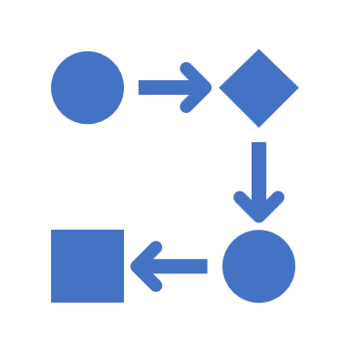


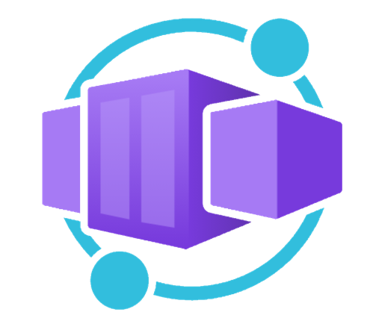





Application hosting continuum
IaaS
Infrastructure Platform
CaaS
Container Orchestration
Platform
PaaS
Application Platform
FaaS
Serverless Platform
Low Code
App and Orchestration
Platform
Virtual Machines
Azure Kubernetes
Service
Azure Container Apps
Azure Spring Apps
Azure App
Service
Azure Functions
Azure Logic
Apps
Power Apps
More Control of execution environment
Less Control of execution environment
Less Agile development & deployment
More Agile development & deployment

Slide 4


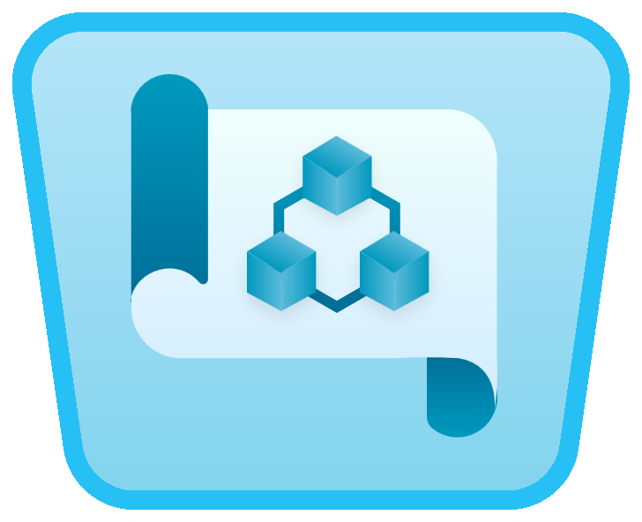
“Serverless” benefits
No server management
Developers can just focus on their code—there are no distractions around server management, capacity planning, or availability.
Event-driven processing
Application components react to events and triggers in real-time.
Consumption billing
Only pay for what you use by automatically scaling up and down based on system usage and throughput.
Microsoft Azure Well-Architected Framework
Guiding tenet, framework and best practices
Reliability, Security, Cost, Operational and Performance
*Supporting services, like storage and networking, may be charged separately.
Notes:
Serverless is actually a misnomer
Still servers behind the scenes running platforms and software
You don’t manage them
Serverless is designed for event-driven processing
The event source can be many things
You only pay for what you use
Azure WAF principles support serverless technology

Slide 5



Serverless architecture
Use case(s) and patterns
Order management
Service delivery
Financial transactions
Azure API Management
(Modify Order)
Azure Event Grid Topic
(New Order Event)
Azure Functions
(Order Processing)
Azure Event Grid Topic
(Order Change Event)
Azure Cosmos DB
(Order Database)
Notes:
A very-high-level architectural diagram of a serverless solution
Two types of events are flowing in
Events from an Event Grid Topic (New Order from up-stream system)
HTTP Request from a client application as a Web API (Modify an order)
Cosmos DB is storing all of the data
One type of event flowing out
Events going to an Event Grid Topic (Downstream system processing of order change events)
All of this is glued together by the code hosted in Azure Functions
Small snippets of code to handle these various cases (All of the order processing functionality)

Slide 6
Anatomy of a Function App
Trigger Event
Trigger Event
Trigger Event
Function App
(Functions)
Notes:
The unit of deployment is a Function App
Each Function App can contain 1 to many Functions
The unit of execution is a Function
Each Function has specific code it executes when triggered

Slide 7
Anatomy of a Function
2. Input Binding(s)
Read data from event (use Input binding)
Read data from external service
1. Trigger
4. Outputs
Event Grid, Logic App, REST, API, …
Write data to external service (use Output binding)
External endpoints using SDK libraries
3. Function Processing & Logic
Notes:
Each individual function has 4 parts
Trigger (Required) – defines what causes a function to execute
Input Binding(s) (Optional) – retrieves additional data before your code executes for usages in your code execution
Logic (Required) – Your code that performs whatever operations you need on the trigger and input binding data
Output Binding(s) (Optional) – Send data on to other event/messaging systems or to databases
Bindings are part of the overall Functions programming model
You don’t have to use them (You can still use SDKs and libraries in your logic to connect to other systems and databases)
They will speed up your development process
Abstract away connection concerns

Slide 8
Thinking about Functions
Integrated programming model
Use built-in triggers and bindings to define when a function is invoked and to what data it connects
Single responsibility
Functions are single-purposed, reusable pieces of code that process an input and return a result
Short lived
Functions don’t stick around when finished executing, freeing up resources for further executions
Enhanced development experience
Code, test and debug locally using your preferred editor or the easy-to-use web-based interface including monitoring
Stateless
Functions don’t hold any persistent state and don’t rely on the state of any other processes
Event driven & scalable
Functions respond to predefined events, and can scale out to handle high-load scenarios
Hosting options flexibility
Choose the deployment model that better fits your business needs without compromising development experience

Slide 9



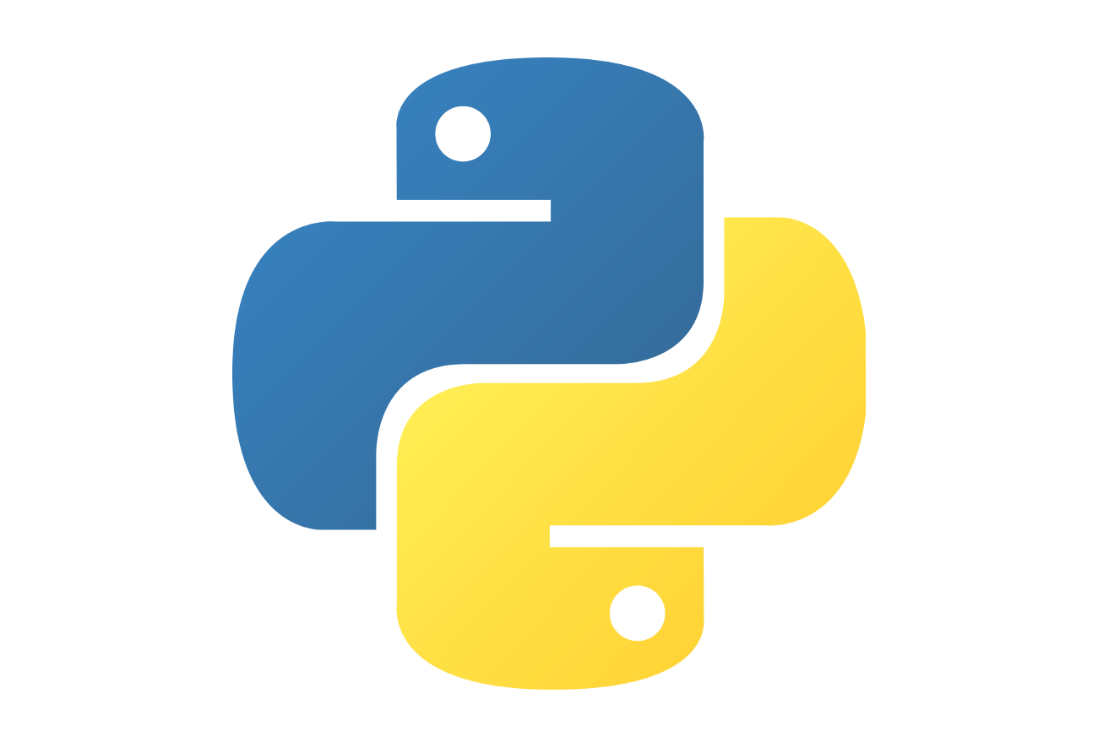




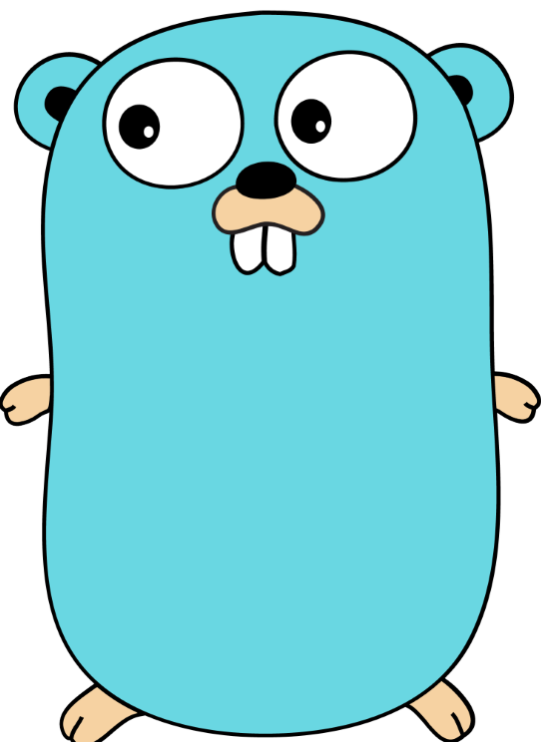
First-class Functions languages
Custom Handlers
Notes:
C#
Java
Python
Powershell
F#
JavaScript
TypeScript (transpiled to JavaScript)
Any language that supports HTTP primitives as Custom Handlers

Slide 10


Events and messaging
Event Grid
Service Bus
Event Hubs
Modern event-based reactive systems (subscription)
Queue or topic; Publish, subscribe model;
1-to-1, or 1-to-many
High throughput event ingestion (streaming, IoT)
Notes:
Event Grid
Create topics for delivering batches of events
Each subscription corresponds to a delivery endpoint
Push based consumption mechanics
Batches of events are pushed to subscribers
Built in Azure system topics (like a blob hits a storage container) and custom defined topics
Service Bus
Queue or Topic (Pub/Sub) mechanism
Queue or Subscription messages are “consumed” (single consumer)
Pull based consumption mechanics
Supports large messages up to 100MB
Event Hubs
Large scale event ingestion
Has Kafka API
Pull based consumption mechanics
Consumers read events from the persistent event log
Consumers keep their own checkpoint to know what events they have already processed

Slide 11






API Management
Developers
Partner Systems
Mobile Apps
Web Apps
APIM policies controls
Subscription
Authorization
Quota, rate-limiting
Transformation
Header, data filtering
APIs (Azure, On-premises, AWS, GCP)
Notes:
API Management acts as a façade for your APIs
The APIs can be hosted anywhere
You can do authorization and authentication at the APIM level before requests hit your APIs
Very helpful when building HTTP triggered functions

Slide 12
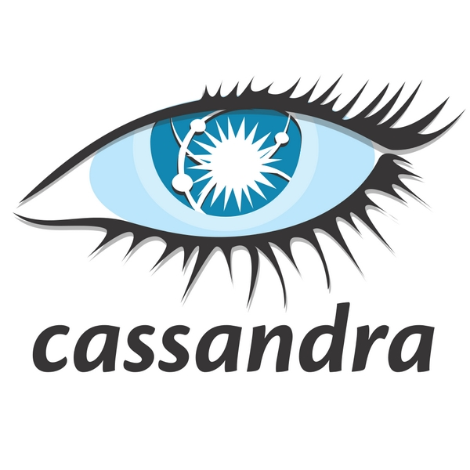




Cosmos DB
Notes:
Fully managed Non-relational database
Choose a specific API when provisioning a Cosmos DB account
Core (SQL) API – Document (JSON not file) database
Mongo DB API – Compatible with MongoDB client libraries, document database
Gremlin API – Graph database
Cassandra API – Column family database
Table API – Key-value pair database
Azure Functions has input & output bindings for the Cosmos Core (SQL) API

Slide 13
Application hosting continuum
IaaS
Infrastructure Platform
CaaS
Container Orchestration
Platform
PaaS
Application Platform
FaaS
Serverless Platform
Low Code
App and Orchestration
Platform
Virtual Machines
Azure Kubernetes
Service
Azure Container Apps
Azure Spring Apps
Azure App
Service
Azure Functions
Azure Logic
Apps
Power Apps
More Control of execution environment
Less Control of execution environment
Less Agile development & deployment
More Agile development & deployment

Slide 14


Sign up for Microsoft.Source
Thank you!
Receive a regular digest of relevant technical content, events and training
Get the best of the newest resources, tools and guidance to help developers quickly build and deploy on Azure
Please fill out the Azure Dev Day Survey!
aka.ms/azuredevdaysurvey
And visit our event content page to access lab materials, presentations and more about the Microsoft Build Conference!
aka.ms/azuredevdaycontent
Get the latest articles, documentation, and events from Microsoft.Source—the curated monthly developer community newsletter.
Stay at the forefront of rapidly evolving technologies with resources that are relevant to your field, location, and areas of interest—including articles, GitHub repositories, and how-to guides.
Get notified about events—from local hacks, workshops, and training sessions to virtual meetups and global conferences.
Learn what you want, when you want, how you want. Resources include in-person hands-on workshops, free, interactive online training and sandbox environments.

Slide 15
Serverless Solutions Lab
Files
Azure Blob Storage
Event Grid
Azure Functions
Cosmos DB
aka.ms/azuredevdaylabs/serverless
Azure Dev Day

